Slide 1
High Resolution Image Synthesis with Latent Diffusion Models
Rombach, Robin, et al.
모바일시스템공학과
박찬호
Rombach, Robin, et al. "High-resolution image synthesis with latent diffusion models." Proceedings of the IEEE/CVF Conference on Computer Vision and Pattern Recognition. 2022.

Slide 2
Contents
Diffusion Recap
DDPM
DDIM
Score-based model
Classifier Guidance
Classifier-free guidance
Architecture
Auto Encoder
UNet
Attention
Results
Conclusion
Test

Slide 3
Before Getting Started
Generative Models Timeline
2014
2015
2016
2017
2018
2019
2020
2021
2022
VAE
Original GAN
PixelRNN
EBGAN
DDPM
DDIM
StyleGAN
Stable Diffusion
DCGAN
First Diffusion*
First Flow-based**
CycleGAN
DeepFakes
PixelCNN++
SAGAN
Score-Based Generative Modeling through Stochastic Differential Equations
Diffusion Models Beat GANs on Image Synthesis
* Jascha Sohl-Dickstein et al. Unsupervised Learning using Nonequilibrium Thermodynamics ** Danilo Jimenez Rezende; Mohamed, Shakir. Variational Inference with Normalizing Flows

Slide 4
Before Getting Started
Generative Models Timeline
2014
2015
2016
2017
2018
2019
2020
2021
2022
VAE
Original GAN
PixelRNN
EBGAN
DDPM
DDIM
StyleGAN
Stable Diffusion
DCGAN
First Diffusion*
First Flow-based**
CycleGAN
DeepFakes
PixelCNN++
SAGAN
Score-Based Generative Modeling through Stochastic Differential Equations
Diffusion Models Beat GANs on Image Synthesis
* Jascha Sohl-Dickstein et al. Unsupervised Learning using Nonequilibrium Thermodynamics ** Danilo Jimenez Rezende; Mohamed, Shakir. Variational Inference with Normalizing Flows

Slide 5

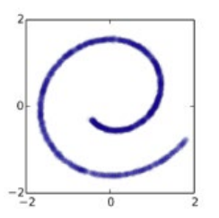
Generative Models
Representative
Generative Models
$$x$$
https://lilianweng.github.io/posts/2021-07-11-diffusion-models/

Slide 6
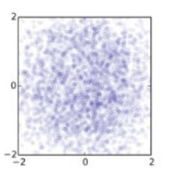
Generative Models – Diffusion Models
$$p\left(\hat{x} \right| z)$$
$$z$$
$$\hat{x}$$
https://www.slideshare.net/HyeongminLee3/pr409-denoising-diffusion-probabilistic-models

Slide 7
Generative Models – Diffusion Models
Fixed!
$$q∙q∙∙∙q∙q$$
$$p∙p∙∙∙p∙p$$
$$x$$
$$z$$
$$\hat{x}$$
Diffusion
Reverse
(Generation)
https://www.slideshare.net/HyeongminLee3/pr409-denoising-diffusion-probabilistic-models

Slide 8
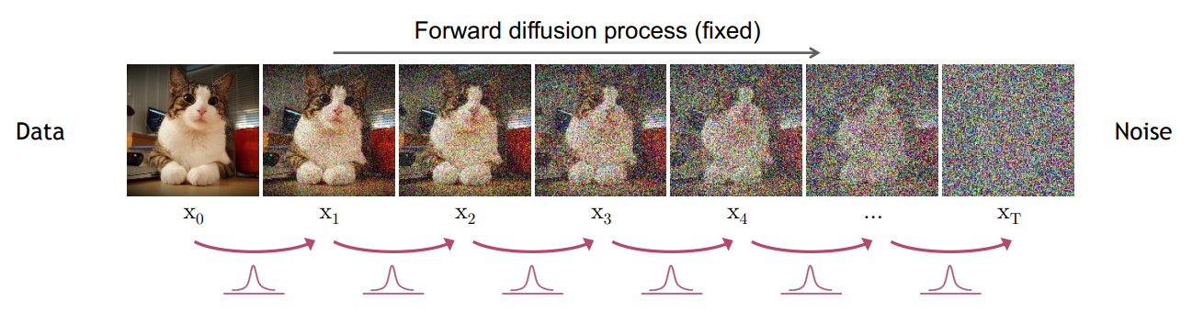
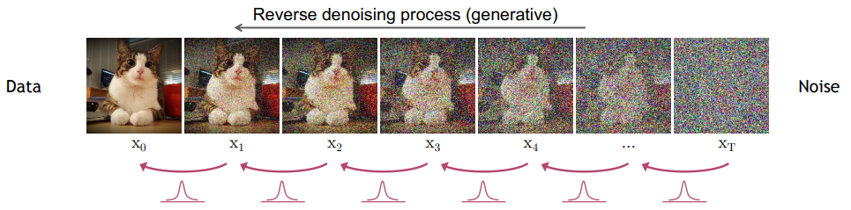
DDPM

Slide 9
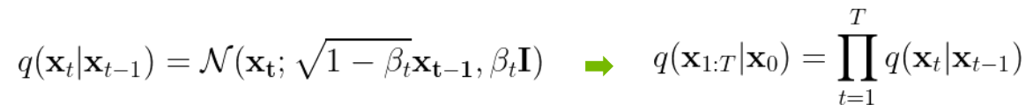
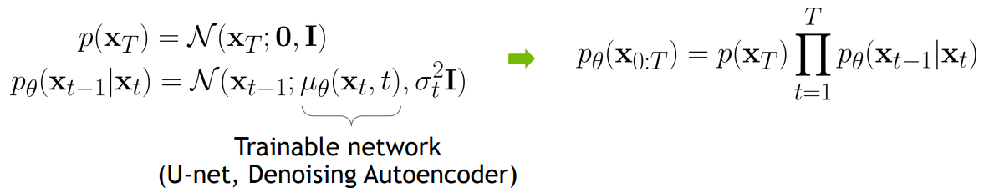
DDPM

Slide 10
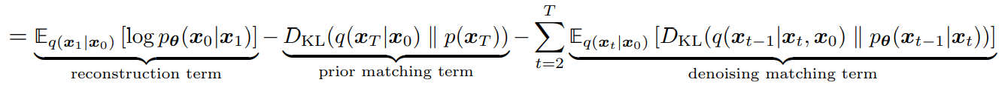
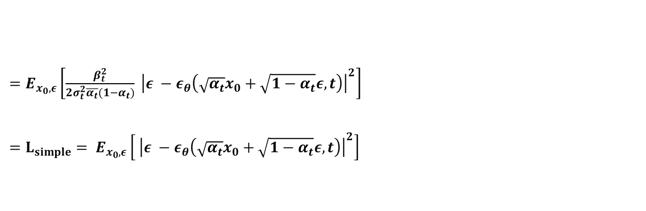
DDPM - Loss
$=E_{x_{0}, ε}\left[\frac{β_{t}^{2}}{2σ_{t}^{2}\overline{α_{t}}(1−α_{t})} {\left|ε −ε_{θ}\left(\sqrt{α_{t}}x_{0}+\sqrt{1−α_{t}}ε, t\right)\right|}^{2}\right]$
$=L_{simple}= E_{x_{0}, ε}\left[ {\left|ε −ε_{θ}\left(\sqrt{α_{t}}x_{0}+\sqrt{1−α_{t}}ε, t\right)\right|}^{2}\right]$

Slide 11
DDPM - Loss
$=E_{x_{0}, ε}\left[\frac{β_{t}^{2}}{2σ_{t}^{2}\overline{α_{t}}(1−α_{t})} {\left|ε −ε_{θ}\left(\sqrt{α_{t}}x_{0}+\sqrt{1−α_{t}}ε, t\right)\right|}^{2}\right]$
$=L_{simple}= E_{x_{0}, ε}\left[ {\left|ε −ε_{θ}\left(\sqrt{α_{t}}x_{0}+\sqrt{1−α_{t}}ε, t\right)\right|}^{2}\right]$
Decreases as time step t increases
Set as 1
MSE between trained epsilon and sample from Standard Gaussian

Slide 12
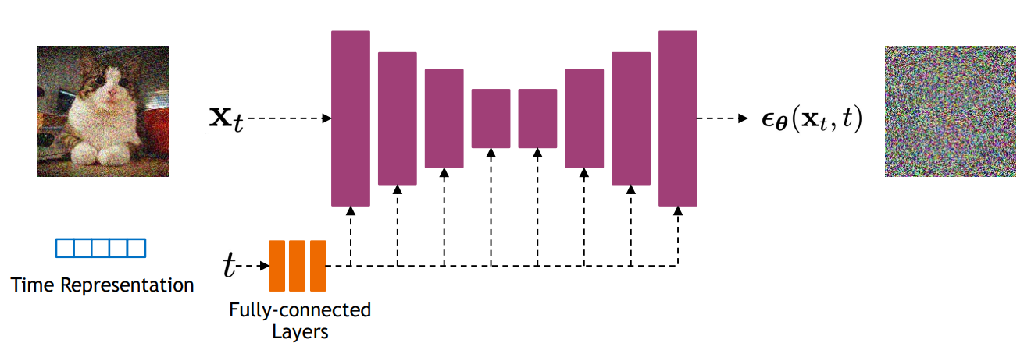
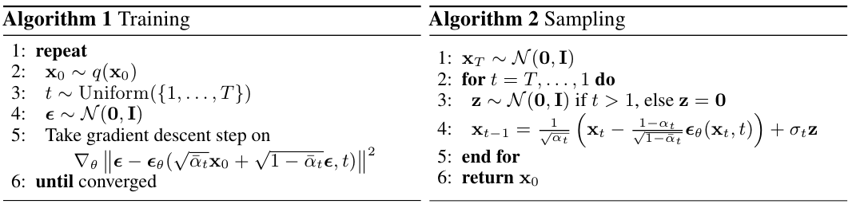
DDPM - Architecture
Backbone of PixelCNN++, which is a U-Net based on ResNet
U-Net with self attention, time representation
U-Net is shared through training
https://nn.labml.ai/diffusion/ddpm/unet.html

Slide 13
DDPM

Slide 14
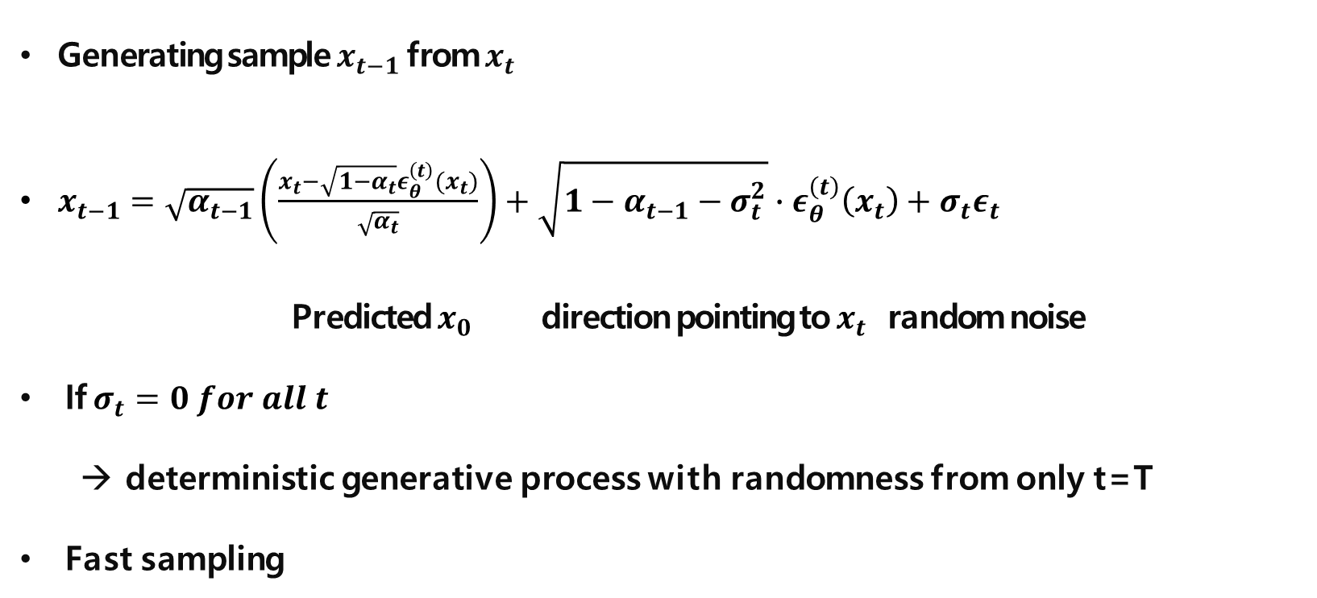
DDIM – Backward
Generating sample $x_{t−1}$ from $x_{t}$
$x_{t−1}=\sqrt{α_{t−1}}\left(\frac{x_{t}−\sqrt{1−α_{t}}ε_{θ}^{\left(t\right)}(x_{t})}{\sqrt{α_{t}}}\right)+\sqrt{1−α_{t−1}−σ_{t}^{2}}∙ε_{θ}^{\left(t\right)}\left(x_{t}\right)+σ_{t}ε_{t}$
Predicted $x_{0}$ direction pointing to $x_{t}$ random noise
If $σ_{t}=0 for all t$
deterministic generative process with randomness from only t=T
Fast sampling

Slide 15
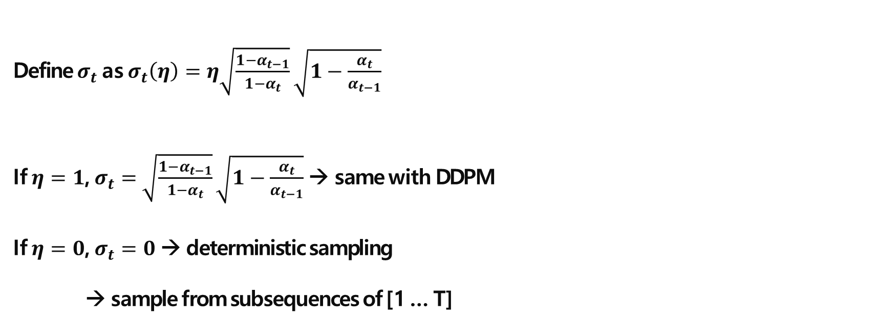
DDIM – Experiments
Define $σ_{t}$ as $σ_{t}\left(η\right)=η\sqrt{\frac{1−α_{t−1}}{1−α_{t}}}\sqrt{1−\frac{α_{t}}{α_{t−1}}}$
If $η=1$, $σ_{t}=$ $\sqrt{\frac{1−α_{t−1}}{1−α_{t}}}\sqrt{1−\frac{α_{t}}{α_{t−1}}}$ → same with DDPM
If $η=0$, $σ_{t}=0$ → deterministic sampling
→ sample from subsequences of [1 … T]

Slide 16
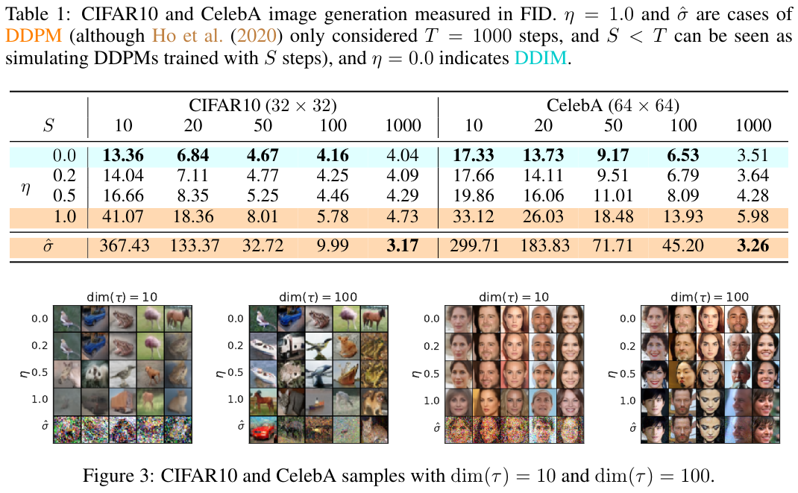
DDIM – Experiments

Slide 17
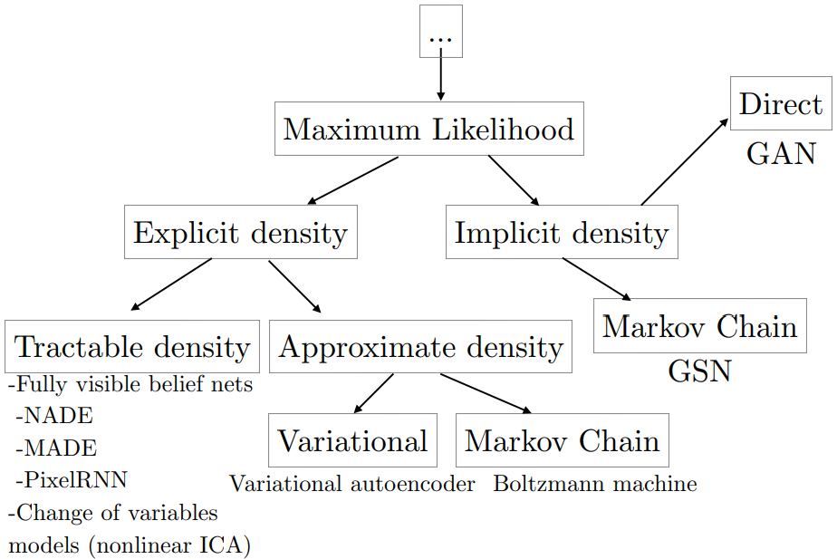
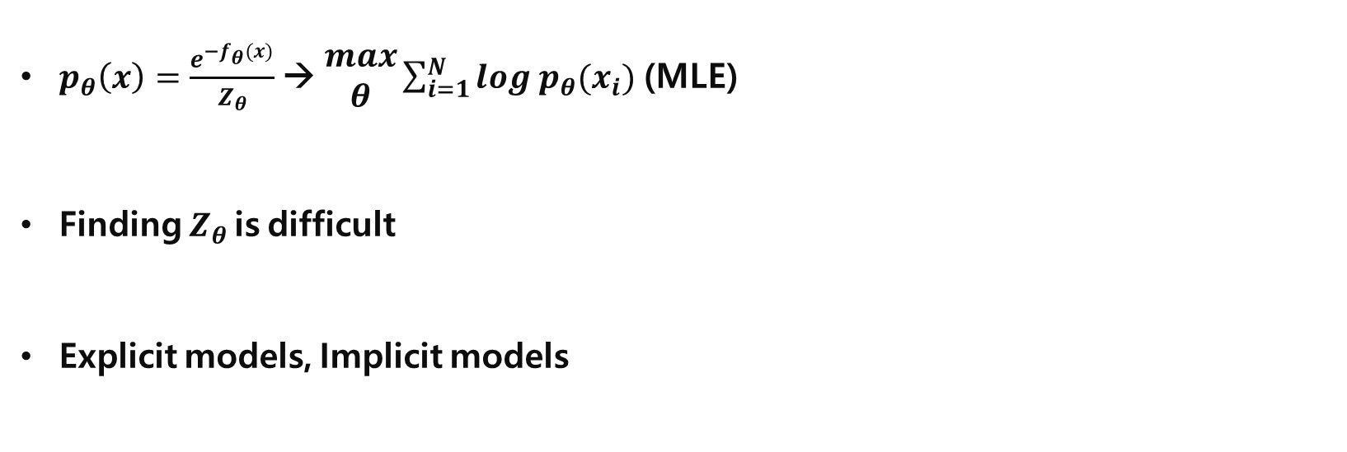
Energy-based Model
$p_{θ}\left(x\right)=\frac{e^{−f_{θ}(x)}}{Z_{θ}}$ → $\begin{aligned}max \\ θ\end{aligned}\sum_{i=1}^{N}{log p_{θ}(x_{i})}$ (MLE)
Finding $Z_{θ}$ is difficult
Explicit models, Implicit models
https://jaejunyoo.blogspot.com/2018/02/energy-based-generative-adversarial-nets-1.html

Slide 18
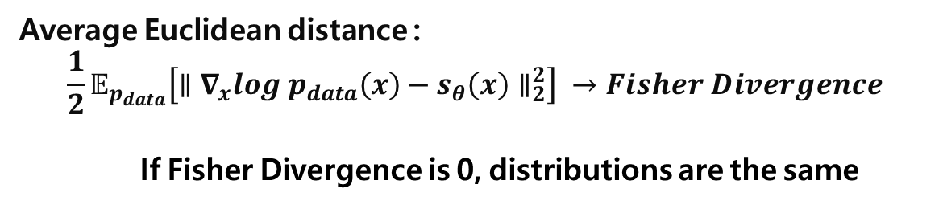
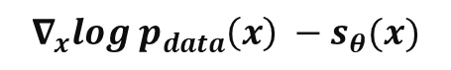
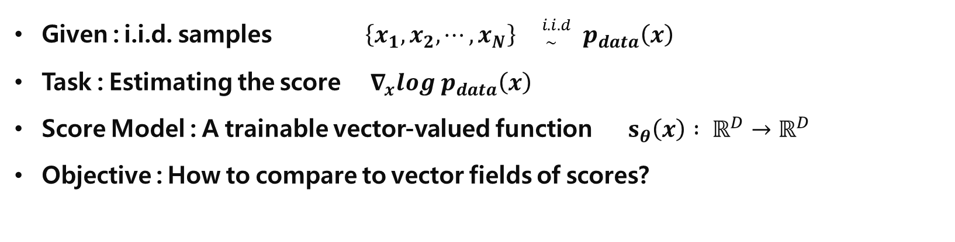
Score Matching
Given : i.i.d. samples $\left\{x_{1}, x_{2}, ⋯, x_{N}\right\} {}_{ \sim }^{i.i.d} p_{data}\left(x\right)$
Task : Estimating the score $∇_{x}log p_{data}\left(x\right)$
Score Model : A trainable vector-valued function $s_{θ}\left(x\right) : ℝ^{D}→ℝ^{D}$
Objective : How to compare to vector fields of scores?
Average Euclidean distance :
$$\frac{1}{2}𝔼_{p_{data}}\left[∥∇_{x}log p_{data}\left(x\right)−s_{θ}\left(x\right)∥_{2}^{2}\right] →Fisher Divergence$$
If Fisher Divergence is 0, distributions are the same
$$∇_{x}log p_{data}\left(x\right) −s_{θ}(x)$$
PR-400: Score-based Generative Modeling Through Stochastic Differential Equations https://youtu.be/uG2ceFnUeQU

Slide 19
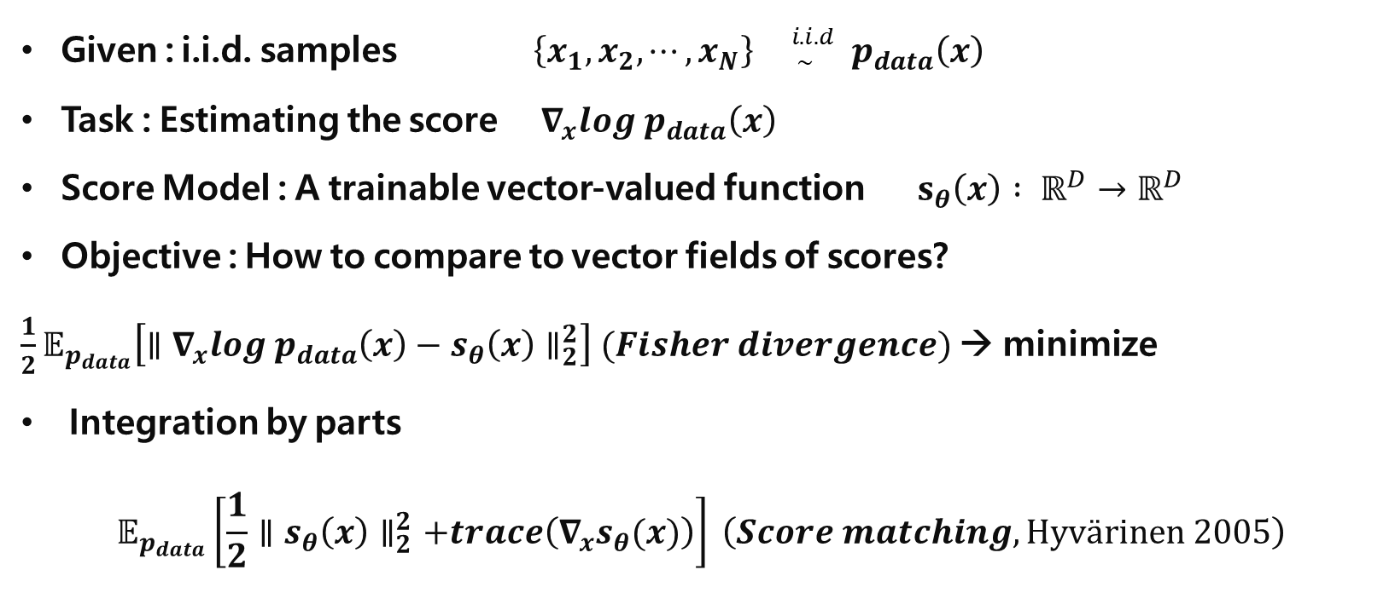
Score Matching
Given : i.i.d. samples $\left\{x_{1}, x_{2}, ⋯, x_{N}\right\} {}_{ \sim }^{i.i.d} p_{data}\left(x\right)$
Task : Estimating the score $∇_{x}log p_{data}\left(x\right)$
Score Model : A trainable vector-valued function $s_{θ}\left(x\right) : ℝ^{D}→ℝ^{D}$
Objective : How to compare to vector fields of scores?
$\frac{1}{2}𝔼_{p_{data}}\left[∥∇_{x}log p_{data}\left(x\right)−s_{θ}\left(x\right)∥_{2}^{2}\right] (Fisher divergence)$ → minimize
Integration by parts
$$𝔼_{p_{data}}\left[\frac{1}{2}∥s_{θ}\left(x\right)∥_{2}^{2}+trace\left(∇_{x}s_{θ}(x)\right)\right] \left(Score matching, Hyvärinen 2005\right)$$
PR-400: Score-based Generative Modeling Through Stochastic Differential Equations https://youtu.be/uG2ceFnUeQU

Slide 20
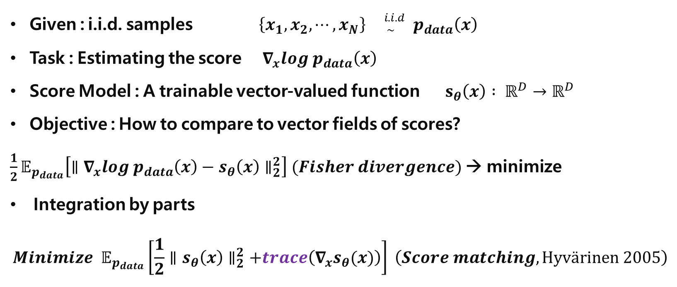
Score Matching
Given : i.i.d. samples $\left\{x_{1}, x_{2}, ⋯, x_{N}\right\} {}_{ \sim }^{i.i.d} p_{data}\left(x\right)$
Task : Estimating the score $∇_{x}log p_{data}\left(x\right)$
Score Model : A trainable vector-valued function $s_{θ}\left(x\right) : ℝ^{D}→ℝ^{D}$
Objective : How to compare to vector fields of scores?
$\frac{1}{2}𝔼_{p_{data}}\left[∥∇_{x}log p_{data}\left(x\right)−s_{θ}\left(x\right)∥_{2}^{2}\right] (Fisher divergence)$ → minimize
Integration by parts
$$Minimize 𝔼_{p_{data}}\left[\frac{1}{2}∥s_{θ}\left(x\right)∥_{2}^{2}+trace\left(∇_{x}s_{θ}(x)\right)\right] \left(Score matching, Hyvärinen 2005\right)$$
Second derivative Negative → maxima
0
→ minima or maxima
trace can be optimized by :
Sliced score matching
Denoising score matching
PR-385: Generative Modeling by Estimating Gradients of the Data Distribution https://youtu.be/m0sehjymZNU

Slide 21
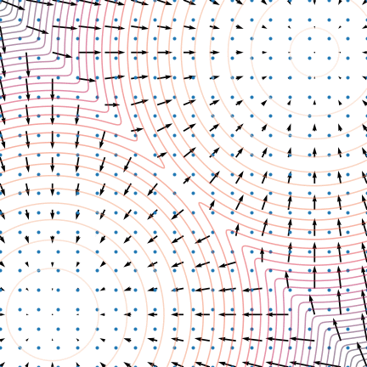
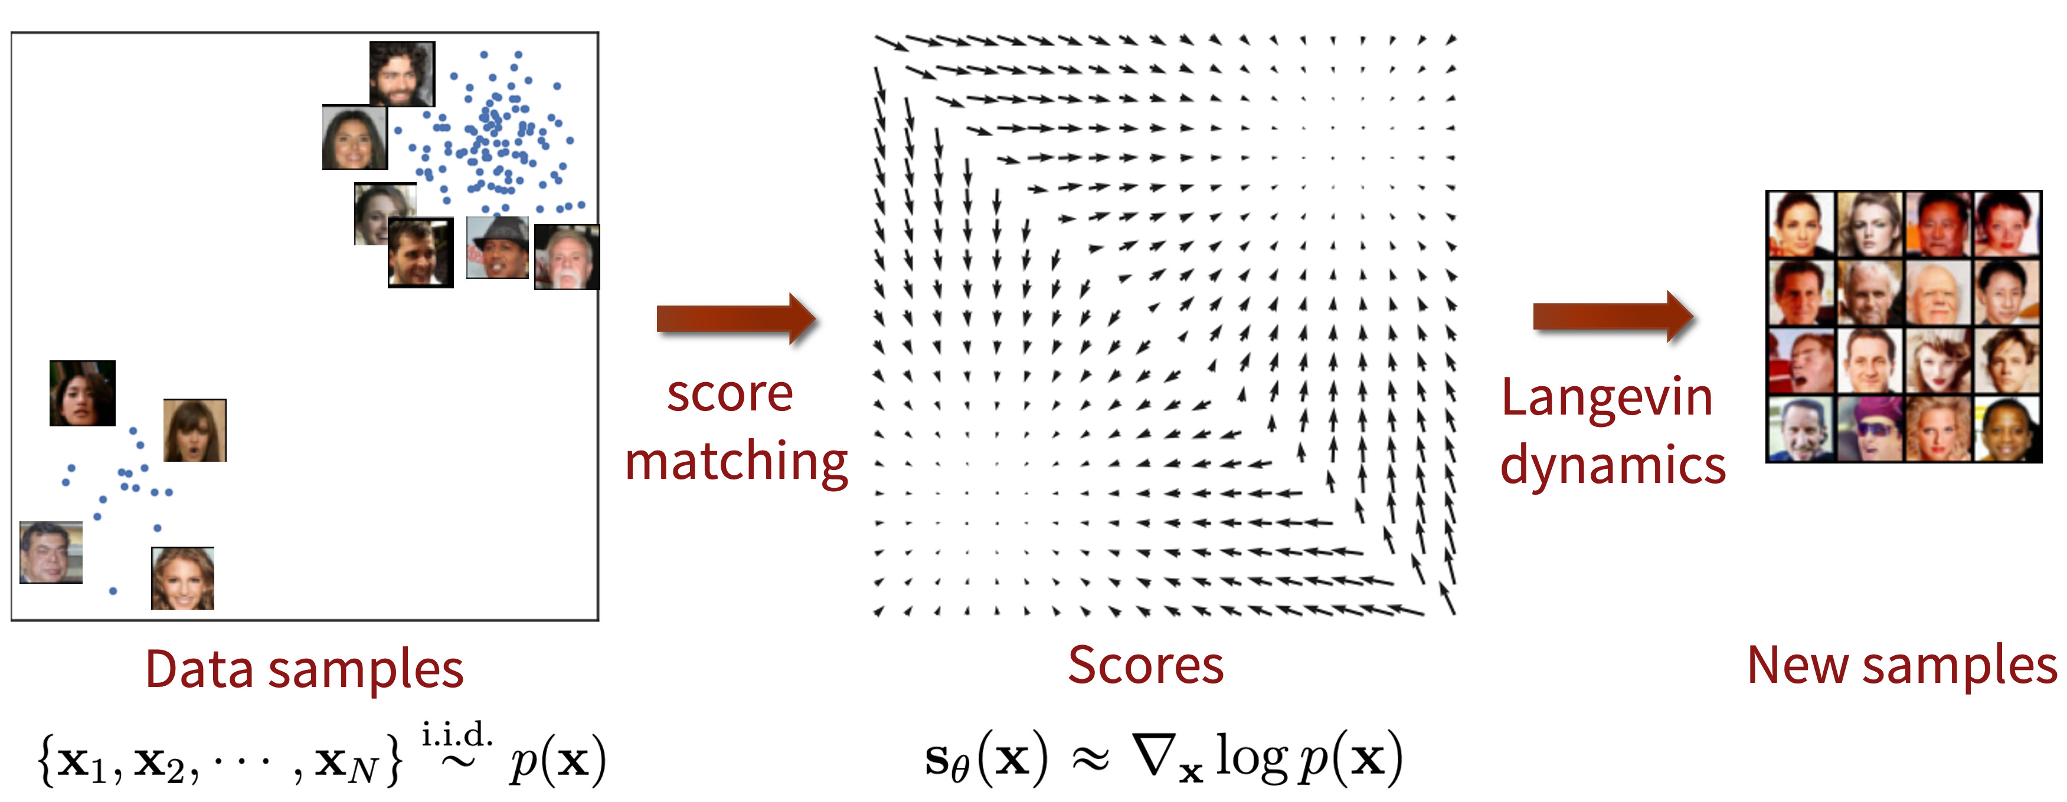
Procedure
Data distribution → Score matching → Score (vector field)
→ Langevin Dynamics (MCMC, Gradient Ascent) → Sampling
Yang Song, [blog] Generative Modeling by Estimating Gradients of the Data Distribution https://yang-song.net/blog/2021/score/

Slide 22
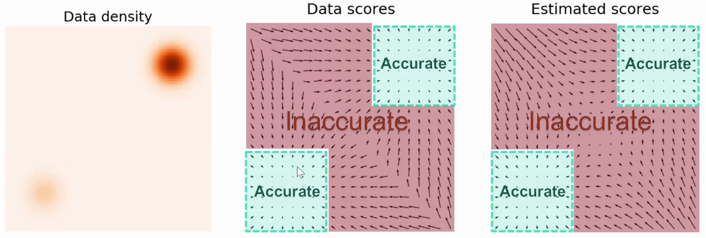
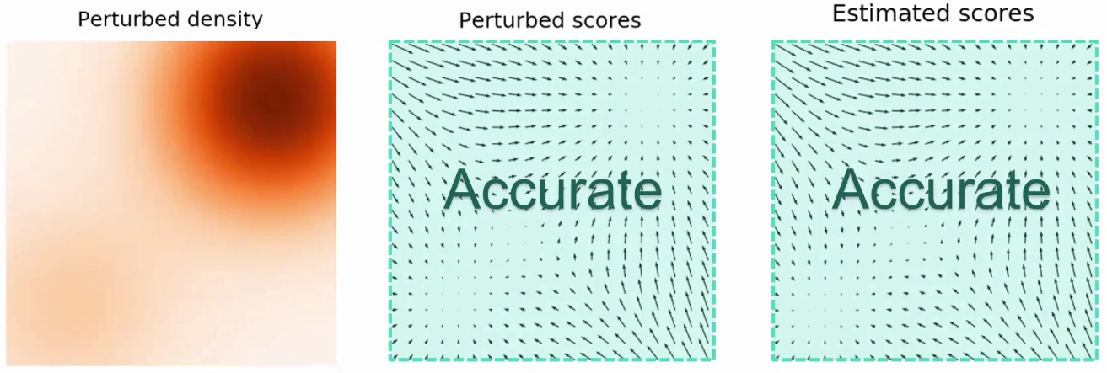
Annealed Langevin Dynamics
Not adding noise to data
Adding Noise to data
Slightly decreasing noise
Gaussian Perturbation
of multiple intensities
https://slideslive.com/38957256/generative-modeling-by-estimating-gradients-of-the-data-distribution

Slide 23
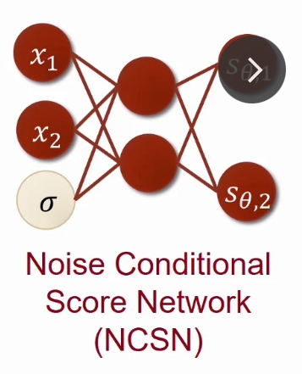
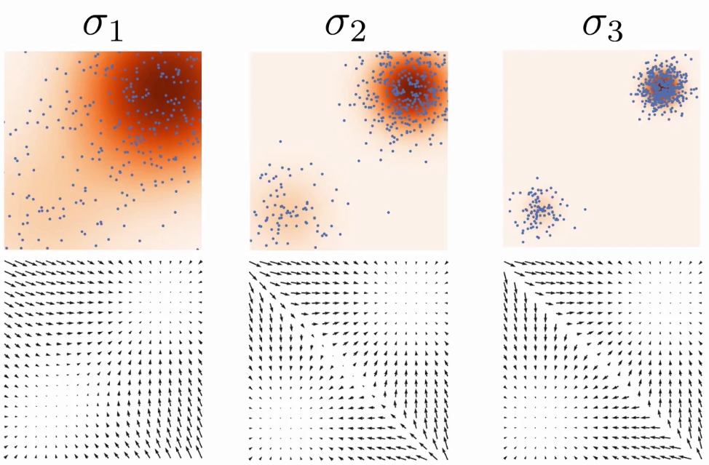
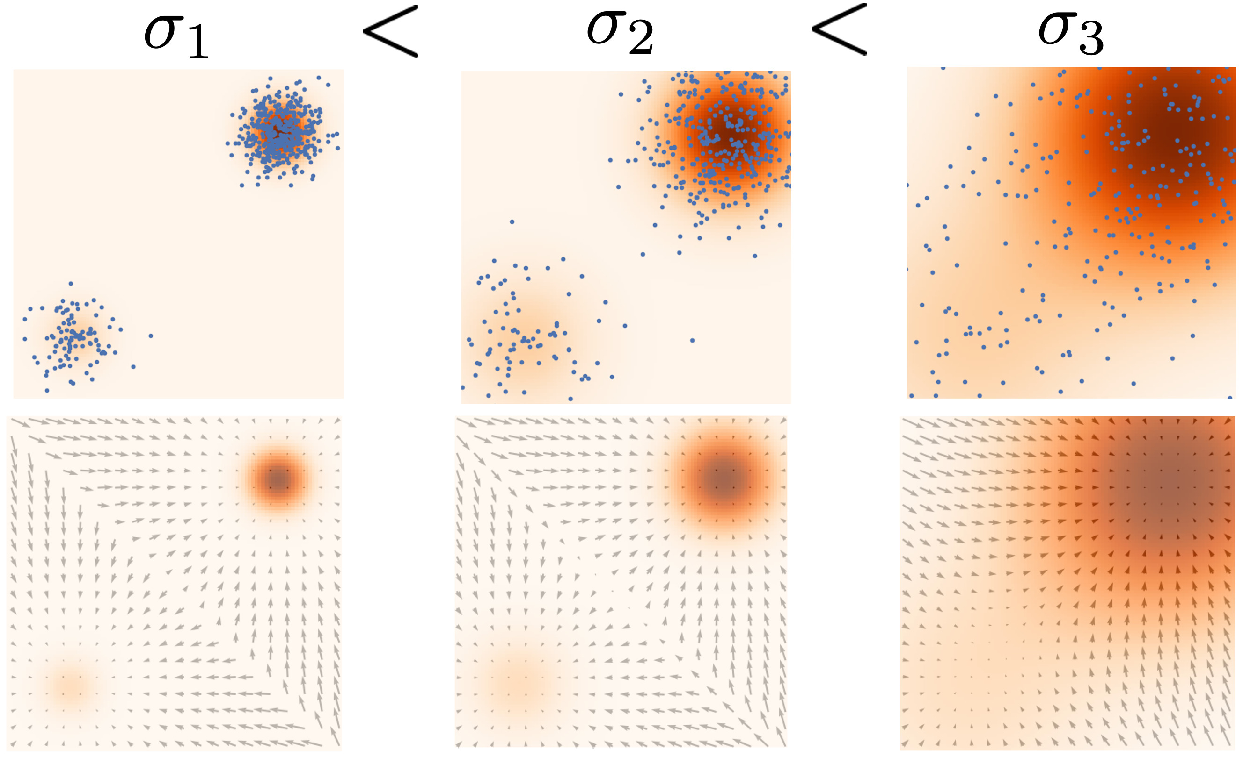
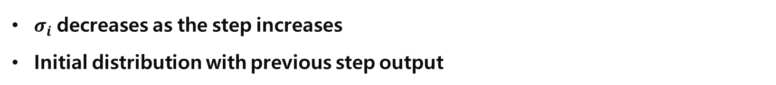
NCSN
$σ_{i}$ decreases as the step increases
Initial distribution with previous step output
https://slideslive.com/38957256/generative-modeling-by-estimating-gradients-of-the-data-distribution

Slide 24
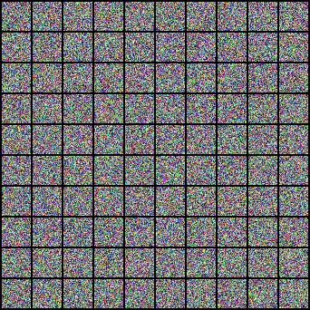
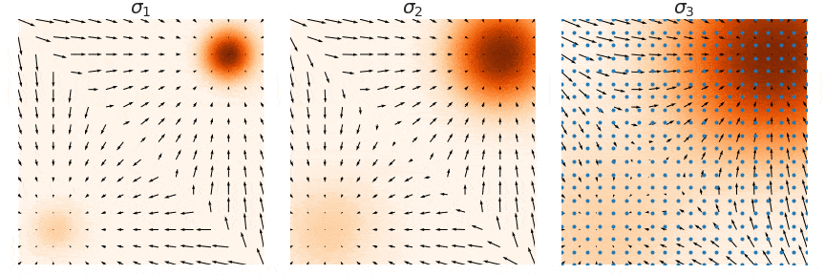
NCSN
https://slideslive.com/38957256/generative-modeling-by-estimating-gradients-of-the-data-distribution

Slide 25
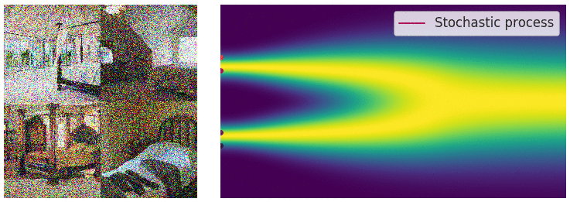
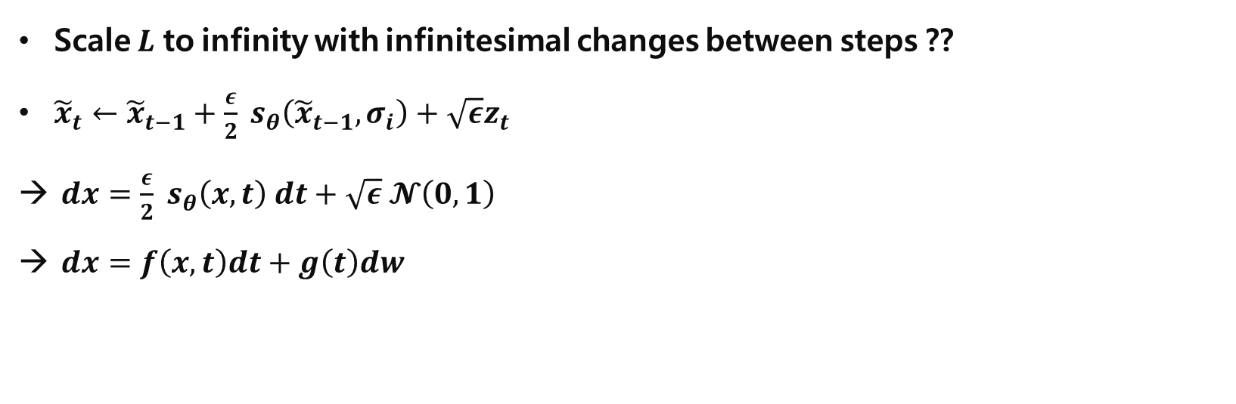
SDE
Scale $L$ to infinity with infinitesimal changes between steps ??
${\tilde{x}}_{t}←{\tilde{x}}_{t−1}+\frac{ε}{2} s_{θ}\left({\tilde{x}}_{t−1}, σ_{i}\right)+\sqrt{ε}z_{t}$
$dx=\frac{ε}{2} s_{θ}\left(x, t\right) dt+\sqrt{ε} 𝓝\left(0, 1\right)$
$dx=f\left(x,t\right)dt+g\left(t\right)dw$
Drift (deterministic; ODE)
Noise (stochastic)
Stochastic Differential Equation
High quality samples with infinitesimal noises
SDE solver, ODE approximation → Faster!
Tractable likelihood estimation..?
And…
Yang Song, [blog] Generative Modeling by Estimating Gradients of the Data Distribution https://yang-song.net/blog/2021/score/

Slide 26
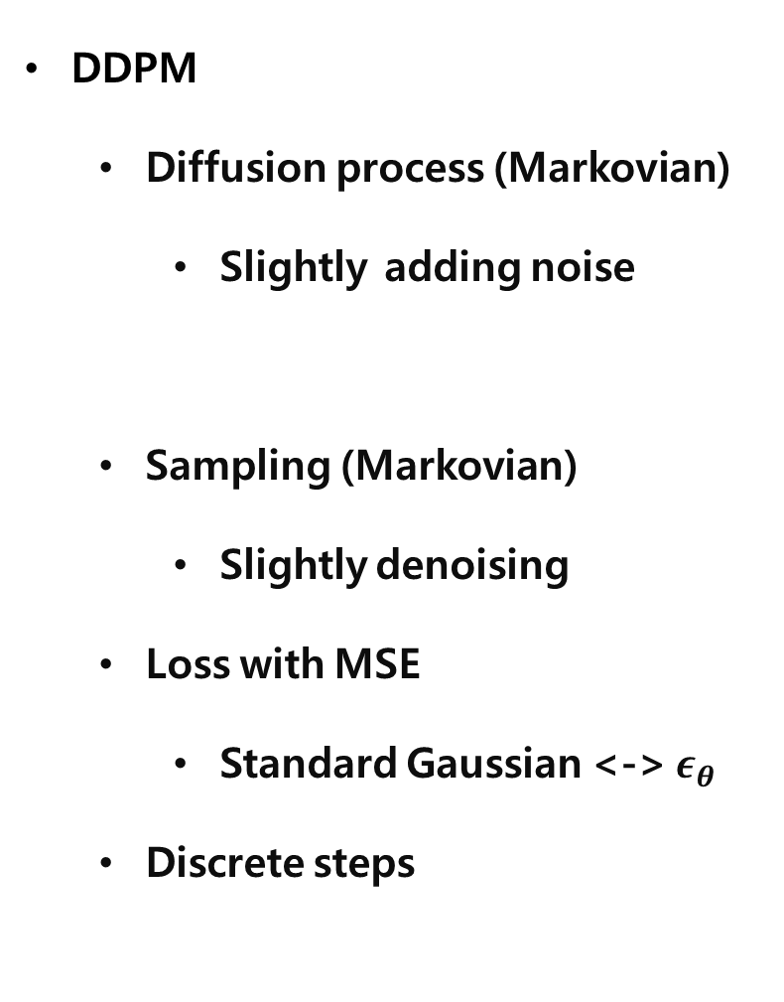
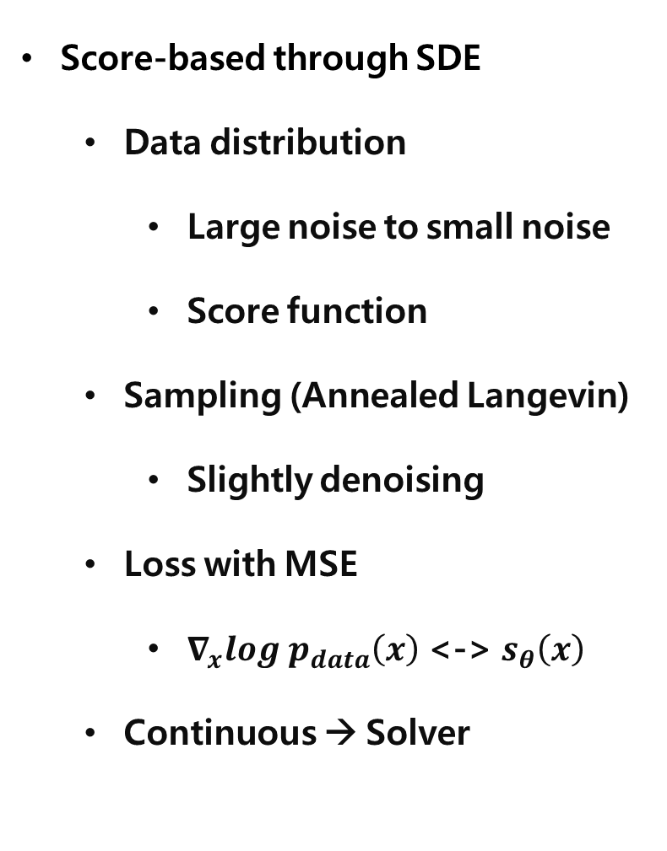
Comparison
DDPM
Diffusion process (Markovian)
Slightly adding noise
Sampling (Markovian)
Slightly denoising
Loss with MSE
Standard Gaussian <-> $ε_{θ}$
Discrete steps
Score-based through SDE
Data distribution
Large noise to small noise
Score function
Sampling (Annealed Langevin)
Slightly denoising
Loss with MSE
$∇_{x}log p_{data}\left(x\right)$ <-> $s_{θ}\left(x\right)$
Continuous → Solver
Same!

Slide 27
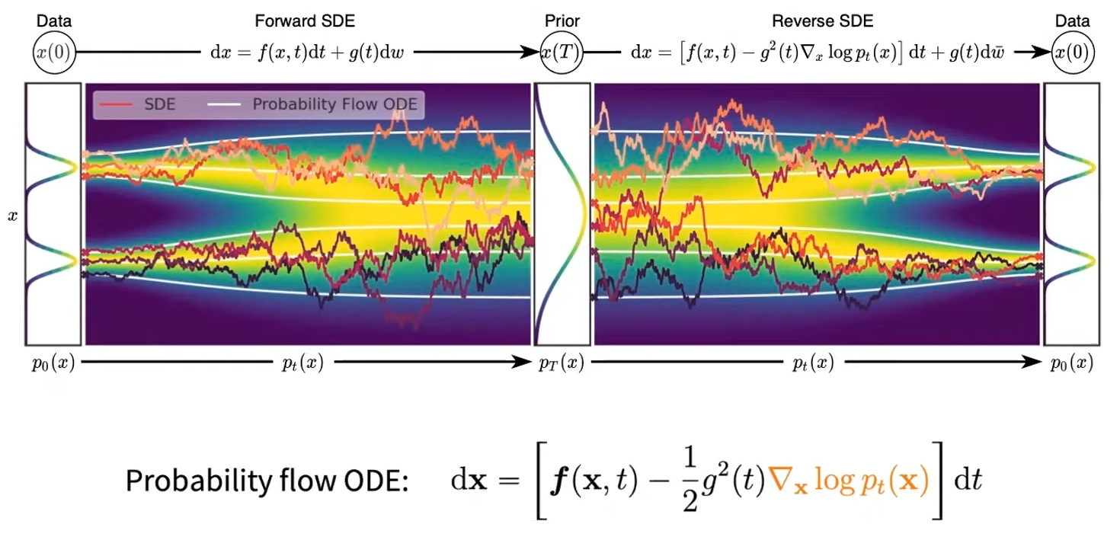
Tractable Likelihood Estimation?
Deterministic
Song, Yang, and Stefano Ermon. "Generative modeling by estimating gradients of the data distribution." Advances in neural information processing systems 32 (2019).

Slide 28
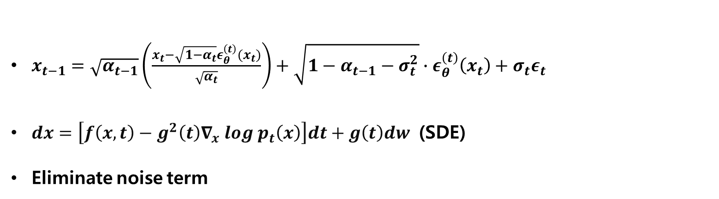
DDIM – Score-based through SDE
$x_{t−1}=\sqrt{α_{t−1}}\left(\frac{x_{t}−\sqrt{1−α_{t}}ε_{θ}^{\left(t\right)}(x_{t})}{\sqrt{α_{t}}}\right)+\sqrt{1−α_{t−1}−σ_{t}^{2}}∙ε_{θ}^{\left(t\right)}\left(x_{t}\right)+σ_{t}ε_{t}$
$dx=\left[f\left(x,t\right)−g^{2}\left(t\right)∇_{x} log p_{t}\left(x\right)\right]dt+g\left(t\right)dw$ (SDE)
Eliminate noise term
Noise term

Slide 29
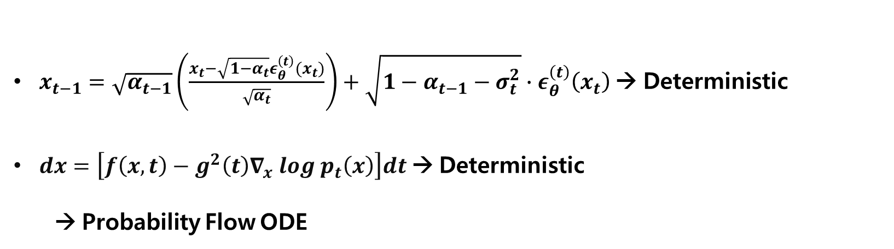
DDIM – Score-based through SDE
$x_{t−1}=\sqrt{α_{t−1}}\left(\frac{x_{t}−\sqrt{1−α_{t}}ε_{θ}^{\left(t\right)}(x_{t})}{\sqrt{α_{t}}}\right)+\sqrt{1−α_{t−1}−σ_{t}^{2}}∙ε_{θ}^{\left(t\right)}\left(x_{t}\right)$ → Deterministic
$dx=\left[f\left(x,t\right)−g^{2}\left(t\right)∇_{x} log p_{t}\left(x\right)\right]dt$→ Deterministic
→ Probability Flow ODE

Slide 30
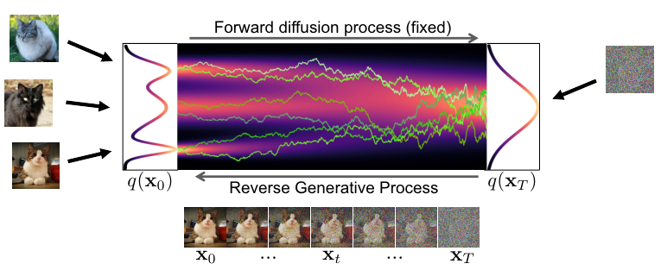
DDIM – Score-based through SDE
$x_{t−1}=\sqrt{α_{t−1}}\left(\frac{x_{t}−\sqrt{1−α_{t}}ε_{θ}^{\left(t\right)}(x_{t})}{\sqrt{α_{t}}}\right)+\sqrt{1−α_{t−1}−σ_{t}^{2}}∙ε_{θ}^{\left(t\right)}\left(x_{t}\right)$ → Deterministic
$dx=\left[f\left(x,t\right)−g^{2}\left(t\right)∇_{x} log p_{t}\left(x\right)\right]dt$→ Deterministic
→ Probability Flow ODE
https://cvpr2022-tutorial-diffusion-models.github.io/

Slide 31
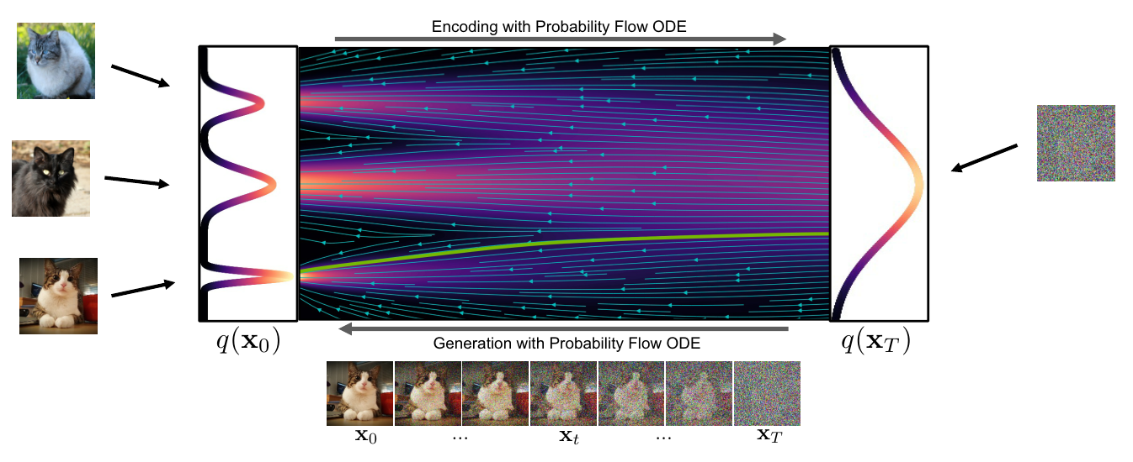
DDIM – Score-based through SDE
$x_{t−1}=\sqrt{α_{t−1}}\left(\frac{x_{t}−\sqrt{1−α_{t}}ε_{θ}^{\left(t\right)}(x_{t})}{\sqrt{α_{t}}}\right)+\sqrt{1−α_{t−1}−σ_{t}^{2}}∙ε_{θ}^{\left(t\right)}\left(x_{t}\right)$ → Deterministic
$dx=\left[f\left(x,t\right)−g^{2}\left(t\right)∇_{x} log p_{t}\left(x\right)\right]dt$→ Deterministic
→ Probability Flow ODE
https://cvpr2022-tutorial-diffusion-models.github.io/

Slide 32
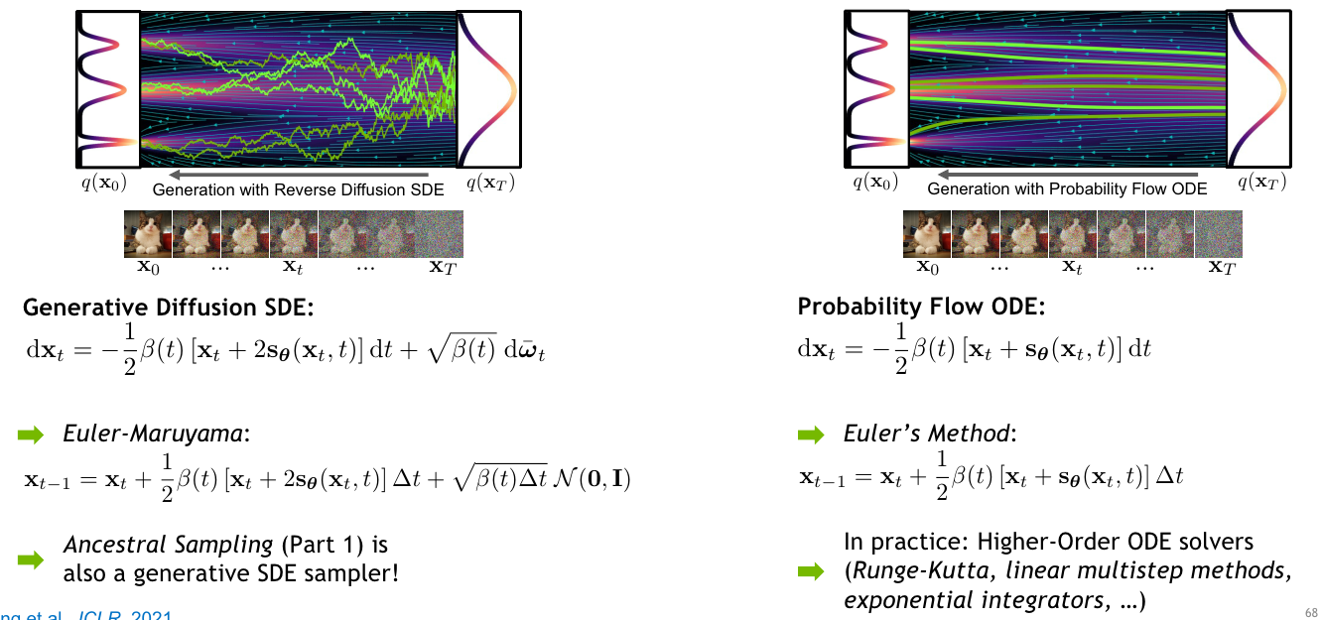
Probability Flow ODE
https://cvpr2022-tutorial-diffusion-models.github.io/

Slide 33
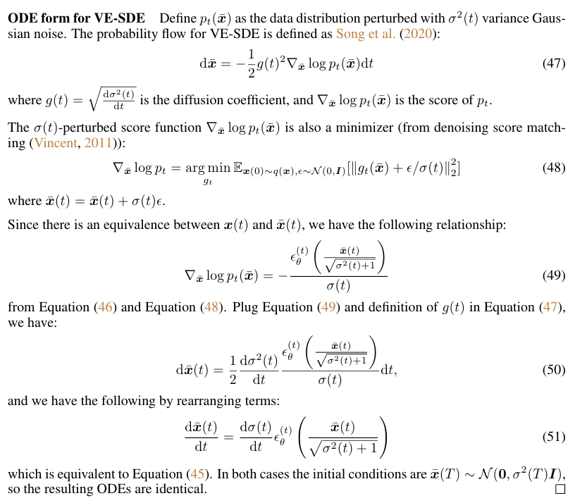
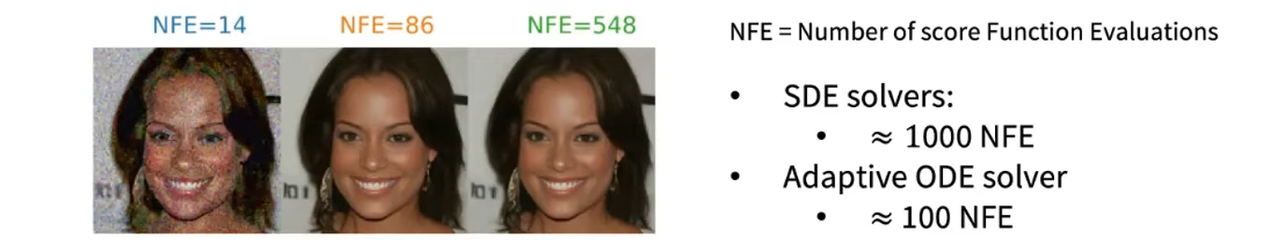
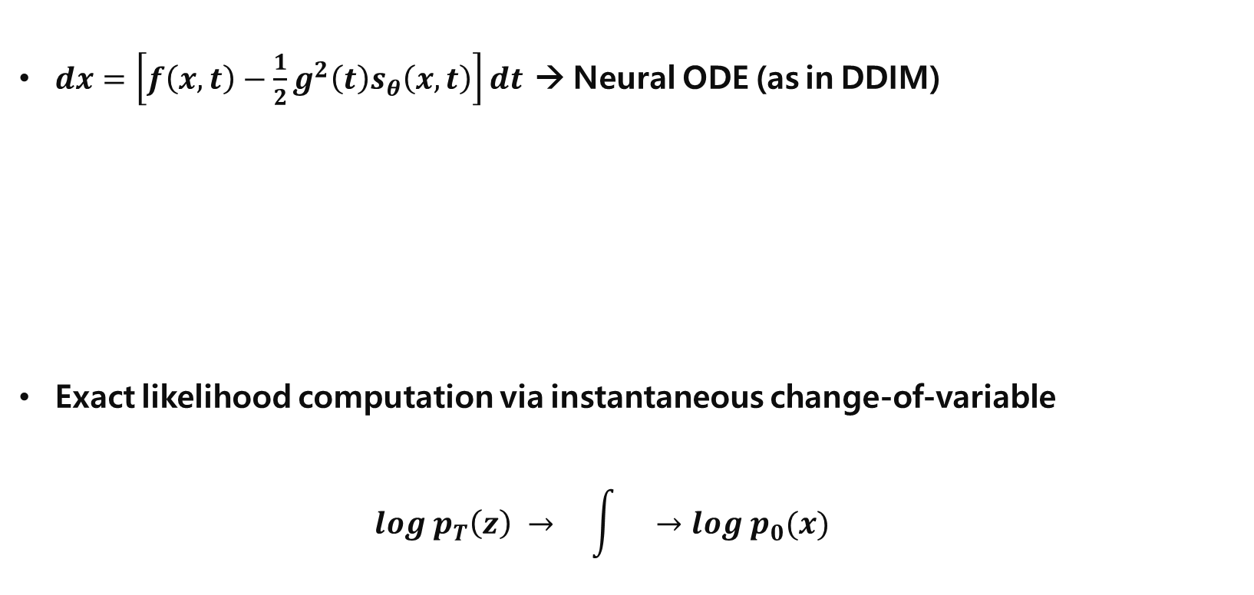
Neural ODE
$dx=\left[f\left(x,t\right)−\frac{1}{2}g^{2}\left(t\right)s_{θ}\left(x,t\right)\right]dt$ → Neural ODE (as in DDIM)
Exact likelihood computation via instantaneous change-of-variable
$$log p_{T}\left(z\right) → \int{}→log p_{0}(x)$$
PR-400: Score-based Generative Modeling Through Stochastic Differential Equations https://youtu.be/uG2ceFnUeQU

Slide 34
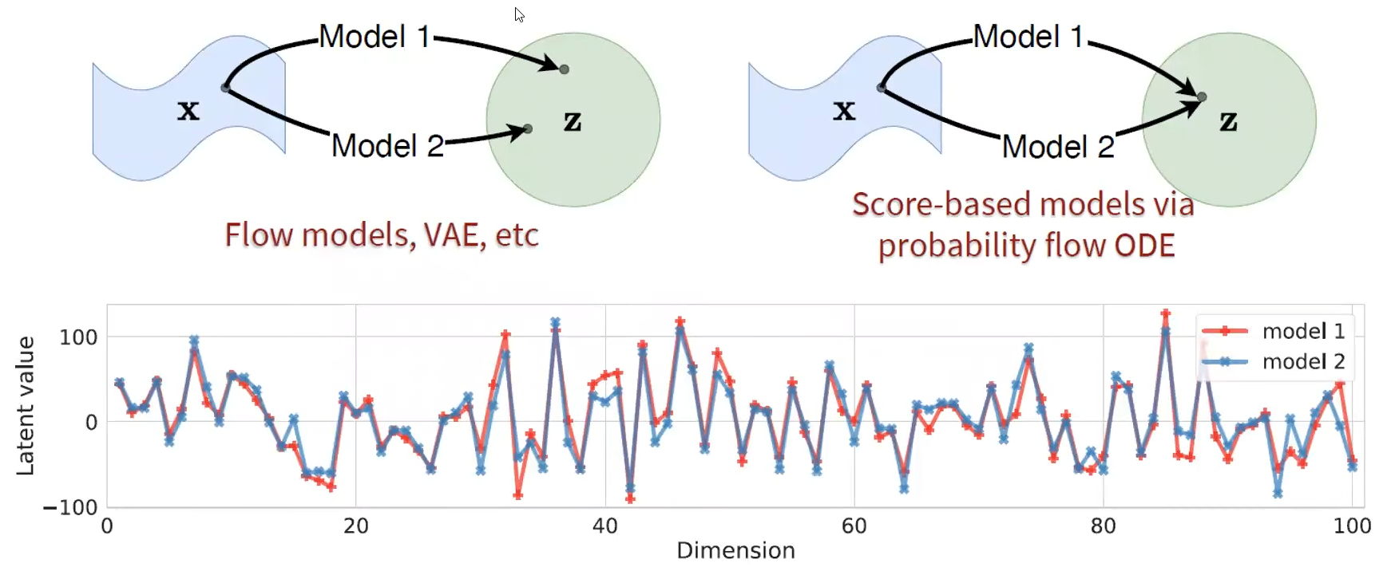
Uniquely Identifiable Encoding
PR-400: Score-based Generative Modeling Through Stochastic Differential Equations https://youtu.be/uG2ceFnUeQU

Slide 35
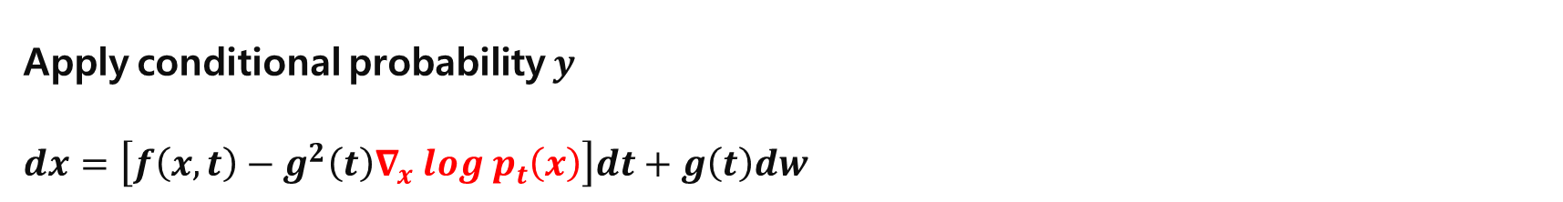
Conditional Generation
Apply conditional probability $y$
$dx=\left[f\left(x,t\right)−g^{2}\left(t\right)∇_{x} log p_{t}\left(x\right)\right]dt+g\left(t\right)dw$

Slide 36
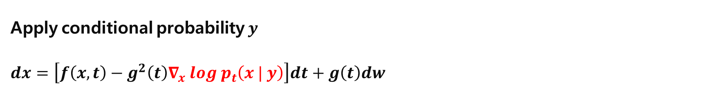
Conditional Generation
Apply conditional probability $y$
$dx=\left[f\left(x,t\right)−g^{2}\left(t\right)∇_{x} log p_{t}\left(x | y\right)\right]dt+g\left(t\right)dw$

Slide 37
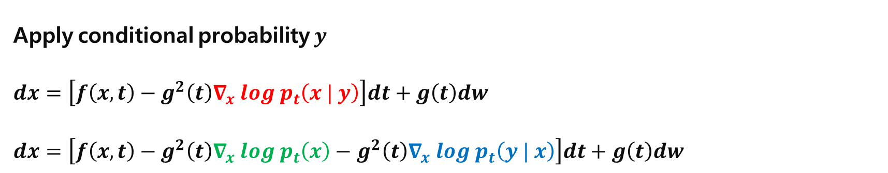
Conditional Generation
Apply conditional probability $y$
$dx=\left[f\left(x,t\right)−g^{2}\left(t\right)∇_{x} log p_{t}\left(x | y\right)\right]dt+g\left(t\right)dw$
$dx=\left[f\left(x,t\right)−g^{2}\left(t\right)∇_{x} log p_{t}\left(x\right)−g^{2}\left(t\right)∇_{x} log p_{t}\left(y | x\right)\right]dt+g\left(t\right)dw$

Slide 38
Conditional Generation
Apply conditional probability $y$
$dx=\left[f\left(x,t\right)−g^{2}\left(t\right)∇_{x} log p_{t}\left(x | y\right)\right]dt+g\left(t\right)dw$
$dx=\left[f\left(x,t\right)−g^{2}\left(t\right)∇_{x} log p_{t}\left(x\right)−g^{2}\left(t\right)∇_{x} log p_{t}\left(y | x\right)\right]dt+g\left(t\right)dw$
Unconditional score function
Not related with Score function
→ Classifier

Slide 39
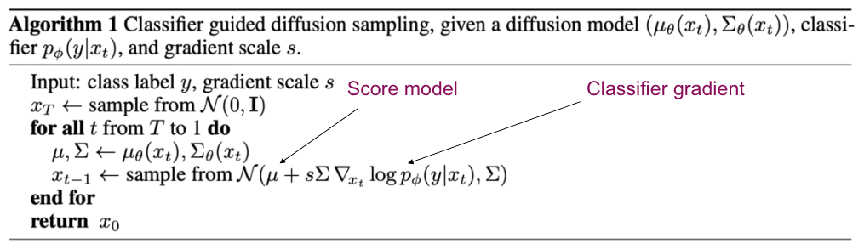
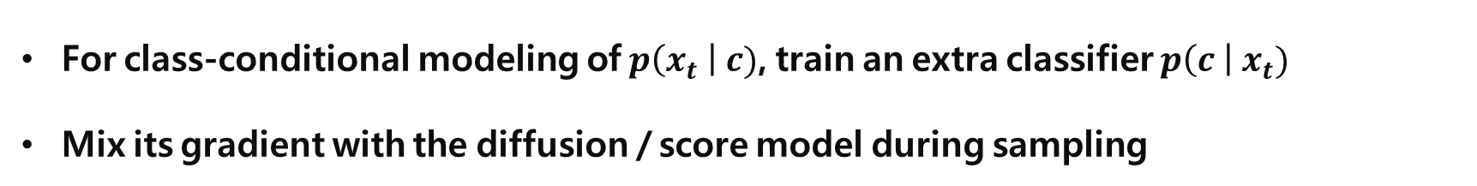
Classifier Guidance
For class-conditional modeling of $p\left(x_{t} \right| c)$, train an extra classifier $p\left(c \right| x_{t})$
Mix its gradient with the diffusion / score model during sampling
Dhariwal, Prafulla, and Alexander Nichol. "Diffusion models beat gans on image synthesis." Advances in Neural Information Processing Systems 34 (2021): 8780-8794.

Slide 40
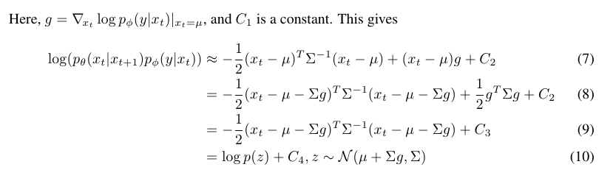
Classifier Guidance
For class-conditional modeling of $p\left(x_{t} \right| c)$, train an extra classifier $p\left(c \right| x_{t})$
Mix its gradient with the diffusion / score model during sampling
Dhariwal, Prafulla, and Alexander Nichol. "Diffusion models beat gans on image synthesis." Advances in Neural Information Processing Systems 34 (2021): 8780-8794.

Slide 41
Classifier Guidance
For class-conditional modeling of $p\left(x_{t} \right| c)$, train an extra classifier $p\left(c \right| x_{t})$
Dhariwal, Prafulla, and Alexander Nichol. "Diffusion models beat gans on image synthesis." Advances in Neural Information Processing Systems 34 (2021): 8780-8794.

Slide 42

Classifier Guidance
For class-conditional modeling of $p\left(x_{t} \right| c)$, train an extra classifier $p\left(c \right| x_{t})$
$dx=\left[f\left(x,t\right)−g^{2}\left(t\right)∇_{x} log p_{t}\left(x_{t} | c\right)\right]dt+g\left(t\right)dw$
$dx=\left[f\left(x,t\right)−g^{2}\left(t\right)∇_{x} log p_{t}\left(x_{t}\right)−g^{2}\left(t\right)∇_{x} log p_{t}\left(c | x_{t}\right)\right]dt+g\left(t\right)dw$
Unconditional score function
Not related with Score function
→ Classifier
Dhariwal, Prafulla, and Alexander Nichol. "Diffusion models beat gans on image synthesis." Advances in Neural Information Processing Systems 34 (2021): 8780-8794.

Slide 43
Classifier Guidance
For class-conditional modeling of $p\left(x_{t} \right| c)$, train an extra classifier $p\left(c \right| x_{t})$
$dx=\left[f\left(x,t\right)−g^{2}\left(t\right)∇_{x} log p_{t}\left(x_{t} | c\right)\right]dt+g\left(t\right)dw$
$dx=\left[f\left(x,t\right)−g^{2}\left(t\right)∇_{x} log p_{t}\left(x_{t}\right)−g^{2}\left(t\right)∇_{x} log p_{t}\left(c | x_{t}\right)\right]dt+g\left(t\right)dw$
Unconditional score function
Not related with Score function
→ Classifier
Dhariwal, Prafulla, and Alexander Nichol. "Diffusion models beat gans on image synthesis." Advances in Neural Information Processing Systems 34 (2021): 8780-8794.

Slide 44
Classifier Guidance
For class-conditional modeling of $p\left(x_{t} \right| c)$, train an extra classifier $p\left(c \right| x_{t})$
$dx=\left[f\left(x,t\right)−g^{2}\left(t\right)∇_{x} log p_{t}\left(x_{t} | c\right)\right]dt+g\left(t\right)dw$
$dx=\left[f\left(x,t\right)−g^{2}\left(t\right)∇_{x} log p_{t}\left(x_{t}\right)−g^{2}\left(t\right)∇_{x} log p_{t}\left(c | x_{t}\right)\right]dt+g\left(t\right)dw$
Unconditional score function
Not related with Score function
→ Classifier
scaling
Dhariwal, Prafulla, and Alexander Nichol. "Diffusion models beat gans on image synthesis." Advances in Neural Information Processing Systems 34 (2021): 8780-8794.

Slide 45
Classifier Guidance
For class-conditional modeling of $p\left(x_{t} \right| c)$, train an extra classifier $p\left(c \right| x_{t})$
$∇_{x} log p_{t}\left(x_{t} | c\right)=∇_{x} log p_{t}\left(x_{t}\right)+{γ ∇}_{x} log p_{t}\left(c | x_{t}\right)$
Unconditional score function
Not related with Score function
→ Classifier
scaling
Dhariwal, Prafulla, and Alexander Nichol. "Diffusion models beat gans on image synthesis." Advances in Neural Information Processing Systems 34 (2021): 8780-8794.

Slide 46

Classifier Guidance
For class-conditional modeling of $p\left(x_{t} \right| c)$, train an extra classifier $p\left(c \right| x_{t})$
$∇_{x} log p_{t}\left(x_{t} | c\right)=∇_{x} log p_{t}\left(x_{t}\right)+{γ ∇}_{x} log p_{t}\left(c | x_{t}\right)$
Unconditional score function
Not related with Score function
→ Classifier
scaling
Dhariwal, Prafulla, and Alexander Nichol. "Diffusion models beat gans on image synthesis." Advances in Neural Information Processing Systems 34 (2021): 8780-8794.

Slide 47
Classifier Guidance
For class-conditional modeling of $p\left(x_{t} \right| c)$, train an extra classifier $p\left(c \right| x_{t})$
$∇_{x} log p_{t}\left(x_{t} | c\right)=∇_{x} log p_{t}\left(x_{t}\right)+{γ ∇}_{x} log p_{t}\left(c | x_{t}\right)$
Diversity – Fidelity tradeoff
Conditional Generation
Unconditional score function
Not related with Score function
→ Classifier
scaling
Dhariwal, Prafulla, and Alexander Nichol. "Diffusion models beat gans on image synthesis." Advances in Neural Information Processing Systems 34 (2021): 8780-8794.

Slide 48

Classifier Guidance
Dhariwal, Prafulla, and Alexander Nichol. "Diffusion models beat gans on image synthesis." Advances in Neural Information Processing Systems 34 (2021): 8780-8794.

Slide 49


Classifier Free Guidance
Classifier Guidance
Pretrained model + Classifier
Classifier should identify class with noisy image $x_{t}$
Can we train $ε_{θ}$ (U-net) with condition?
→ Classifier Free Guidance

Slide 50

Classifier Free Guidance
Classifier Free Guidance
$∇_{x} log p_{γ}\left(x | y\right)=∇_{x} log p\left(x\right)+γ{ ∇}_{x} log p\left(y | x\right)$
$log p\left(y | x\right)=log p\left(x \right| y) −log p\left(x\right)$
$∇_{x} log p_{γ}\left(x | y\right)=∇_{x} log p\left(x\right)+γ \left\{∇_{x} log p\left(x | y\right) −log p(x)\right\}$
$∇_{x} log p_{γ}\left(x | y\right)=$ $\left(1−γ\right) ∇_{x} log p\left(x\right)+γ ∇_{x} log p\left(x | y\right)$
Set $−ω=1−γ$
→ $∇_{x} log p_{γ}\left(x | y\right)=$ $−ω ∇_{x} log p\left(x\right)+(1+ω) ∇_{x} log p\left(x | y\right)$
→ $∇_{x} log p_{γ}\left(x | y\right)=$ $(1+ω) ∇_{x} log p\left(x | y\right)−ω ∇_{x} log p\left(x\right)$

Slide 51

Classifier Free Guidance
Classifier Free Guidance
$∇_{x} log p_{γ}\left(x | c\right)=$ $(1+ω) ∇_{x} log p\left(x | c\right)−ω ∇_{x} log p\left(x\right)$
${\tilde{ε}}_{t}=\left(1+ω\right) ε_{θ}\left(z_{t}, c\right) −ω ε_{θ}(z_{t})$
For $ε_{θ}(z_{t})$, train $ε_{θ}\left(z_{t}, c\right)$ with $c= ∅$
If giving label as caption, $∅$ is giving null sentence as caption
Can apply various sampling methods
No need to train classifier which can identify noisy image

Slide 52

Classifier Free Guidance
https://cvpr2022-tutorial-diffusion-models.github.io/

Slide 53

Architecture
Auto Encoder
U-Net
Attention
Rombach, Robin, et al. "High-resolution image synthesis with latent diffusion models." Proceedings of the IEEE/CVF Conference on Computer Vision and Pattern Recognition. 2022.

Slide 54

Architecture
Auto Encoder → Diffusion at latent space
Perceptual loss : Difference between feature maps of pretrained-CNN
Patch-based adversarial object : local realism, avoid blurriness
Regularization
Latent feature $z$
Rombach, Robin, et al. "High-resolution image synthesis with latent diffusion models." Proceedings of the IEEE/CVF Conference on Computer Vision and Pattern Recognition. 2022.

Slide 55

Architecture
Diffusion process
: Various diffusion models appropriate, but the best is classifier-free guidance
Conditioning with vector space embedded conditions
Semantic Map
Text
…
Rombach, Robin, et al. "High-resolution image synthesis with latent diffusion models." Proceedings of the IEEE/CVF Conference on Computer Vision and Pattern Recognition. 2022.

Slide 56
Architecture
Sampling process
DDIM sampler
Add attention between U-Net Layers
Self-Attention
Cross-Attention
→ Transformer
Rombach, Robin, et al. "High-resolution image synthesis with latent diffusion models." Proceedings of the IEEE/CVF Conference on Computer Vision and Pattern Recognition. 2022.

Slide 57



Architecture
$τ_{θ}$ is Transformer Encoder
Residual → Transformer Decoder
For condition as query
Answer with U-Net representation
Rombach, Robin, et al. "High-resolution image synthesis with latent diffusion models." Proceedings of the IEEE/CVF Conference on Computer Vision and Pattern Recognition. 2022.

Slide 58
Architecture
$τ_{θ}$ is Transformer Encoder
Residual → Transformer Decoder
For condition as query
Answer with U-Net representation
Rombach, Robin, et al. "High-resolution image synthesis with latent diffusion models." Proceedings of the IEEE/CVF Conference on Computer Vision and Pattern Recognition. 2022.

Slide 59
Architecture
$τ_{θ}$ is Transformer Encoder
Residual → Transformer Decoder
For condition as query
Answer with U-Net representation
Rombach, Robin, et al. "High-resolution image synthesis with latent diffusion models." Proceedings of the IEEE/CVF Conference on Computer Vision and Pattern Recognition. 2022.

Slide 60

Results
https://github.com/CompVis/latent-diffusion

Slide 61

Results
Rombach, Robin, et al. "High-resolution image synthesis with latent diffusion models." Proceedings of the IEEE/CVF Conference on Computer Vision and Pattern Recognition. 2022.

Slide 62
Conclusion
Latent Diffusion model
Auto Encoder : Pixel Space → Latent Space
Conditional sampling with Transformer (attention)
Democratizing High-Resolution Image Synthesis
Reducing computational cost → Increase accessibility
Stable Diffusion
Large-size Image Generation
Rombach, Robin, et al. "High-resolution image synthesis with latent diffusion models." Proceedings of the IEEE/CVF Conference on Computer Vision and Pattern Recognition. 2022.

Slide 63

Conclusion
Latent Diffusion model
Auto Encoder : Pixel Space → Latent Space
Conditional sampling with Transformer (attention)
Democratizing High-Resolution Image Synthesis
Reducing computational cost → Increase accessibility
Stable Diffusion
Large-size Image Generation
A high tech solarpunk utopia in the Amazon rainforest
Rombach, Robin, et al. "High-resolution image synthesis with latent diffusion models." Proceedings of the IEEE/CVF Conference on Computer Vision and Pattern Recognition. 2022.

Slide 64
Conclusion
Latent Diffusion model
Auto Encoder : Pixel Space → Latent Space
Conditional sampling with Transformer (attention)
Democratizing High-Resolution Image Synthesis
Reducing computational cost → Increase accessibility
Stable Diffusion
Large-size Image Generation
Rombach, Robin, et al. "High-resolution image synthesis with latent diffusion models." Proceedings of the IEEE/CVF Conference on Computer Vision and Pattern Recognition. 2022.

Slide 65

Before SR

Slide 66

After SR

Slide 67

Before SR

Slide 68

After SR

Slide 69

Ground Truth

Slide 70
Thank
You
감사합니다.

